Slide 1


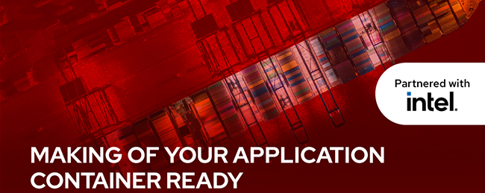
A Journey through expertise...
LEAP
Academy

Slide 2


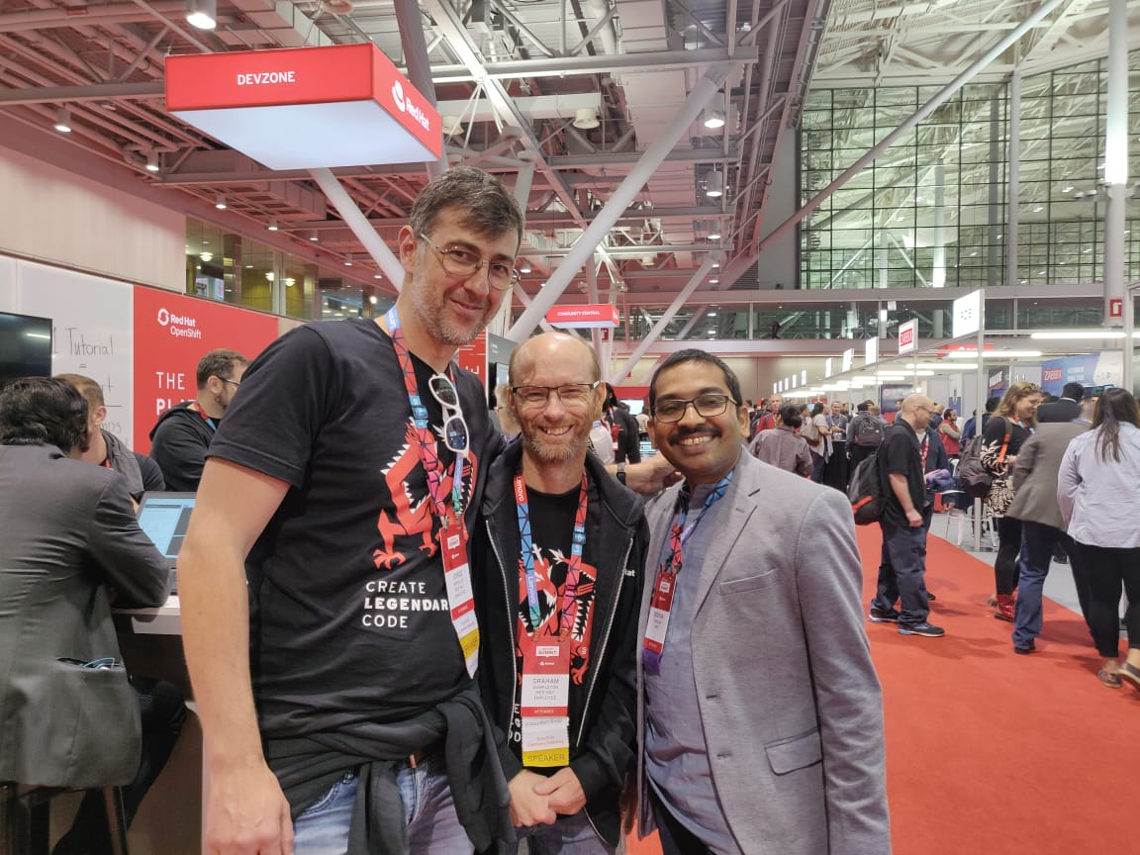
@RedHat_Summit
Deepak Mishra
(CEO and Founder of Prodevans Technologies)
Graham Dumpleton
(The author of two O'Reilly books on OpenShift: OpenShift for Developers, and Deploying to OpenShift)

Slide 3
AGENDA
1. Overview of container technology
2. Overview of container architecture
3. Overview of Kubernetes and OpenShift
4. Provisioning a containerized database server
5. Building custom container images with Dockerfile
6. Creating basic Kubernetes and OpenShift resources
7. Creating routes
8. Creating applications with the source-to-image facility
9. Creating applications with Red Hat OpenShift web console

Slide 4
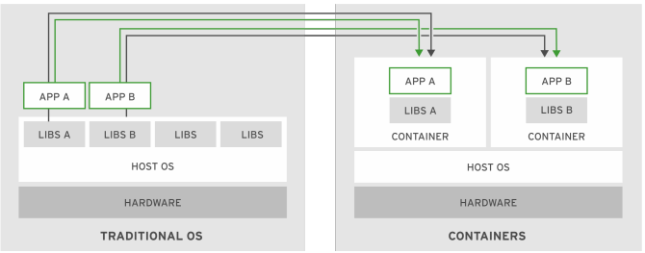
CONTAINER TECHNOLOGY
What are containers?
Containers are a set of one or more processes that are isolated from the rest of the system.
Enterprise Requirements
Low Hardware Footprint.
Quick and Reusable Deployment.
Multiple Environment Deployment.

Slide 5
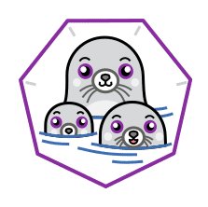
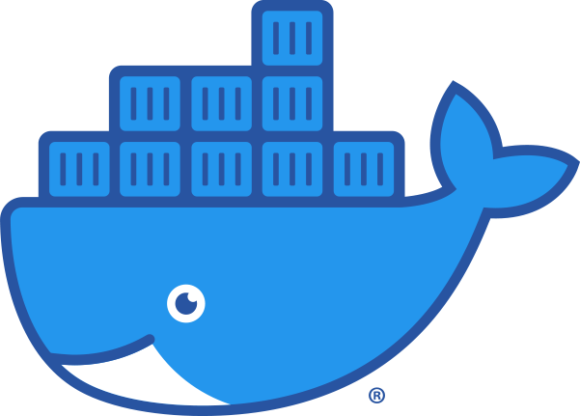
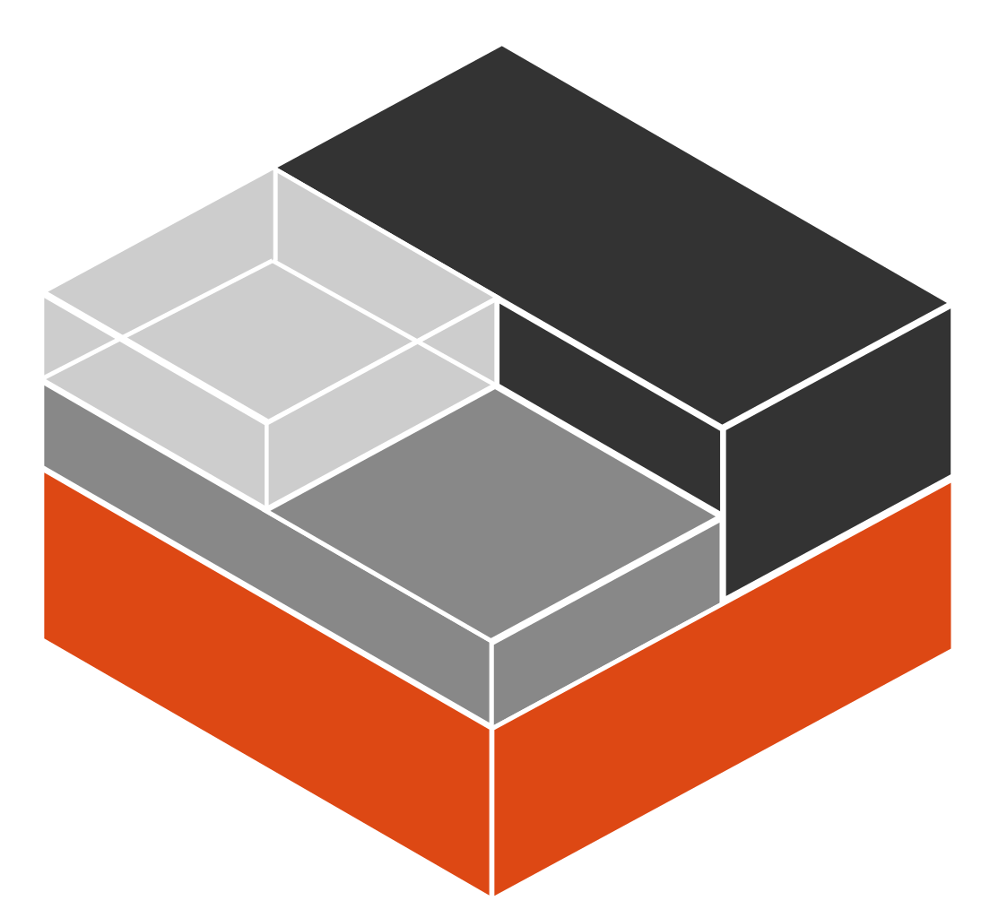
CONTAINER ARCHITECTURE
How do containers work?
Namespaces
Control groups (cgroups)
Seccomp
SELinux
Linux Container Architecture Terms
Containers.
Image
Image Repository
Podman
Container
IMAGE
REPOSITORY
IMAGE
Container
Container

Slide 6
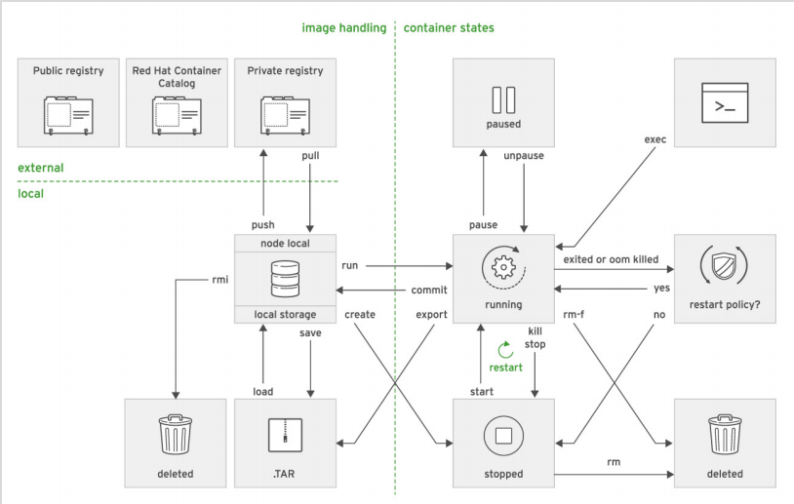
CONTAINER LIFE CYCLE MANAGEMENT
WITH PODMAN
Podman Managing Subcommands

Slide 7


Need of OPENSHIFT AND KUBERNETES
Limitation of Containers
As the number of containers managed by an organization grows, so is the manually starting too exponentially which is directly proportional to quick response to external demands.
Enterprise Needs:
Easy communication between a large number of services.
Resource limits on applications regardless of the number of containers running them.
To respond to application usage spikes to increase or decrease running containers.
To react to service deterioration with health checks.
Gradual/Smooth roll out of a new release to a set of users.

Slide 8
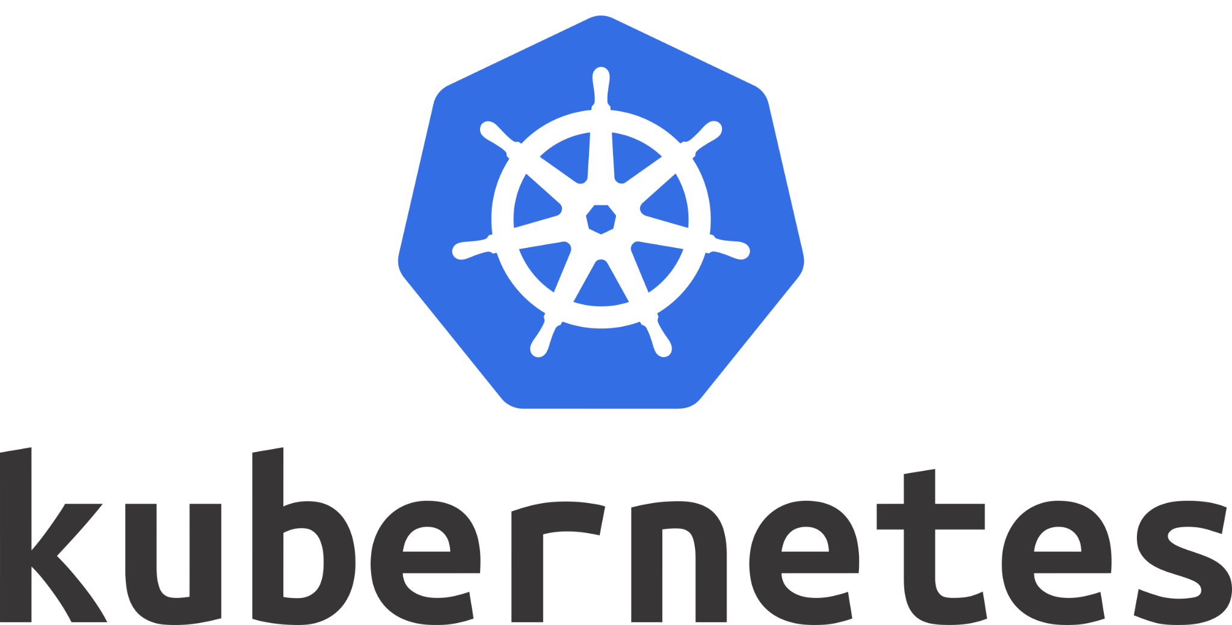
OPENSHIFT AND KUBERNETES
ORCHESTRATION
SCHEDULING
HIGH AVAILABILITY
Three challenges of a container cluster architecture:
Orchestration
Scheduling
Isolation
Kubernetes Features:
Service discovery and load balancing
Horizontal Scaling
Self-healing with user defined health checks
Automated rollout and rollback
Secrets and Configuration Management.
Operators

Slide 9

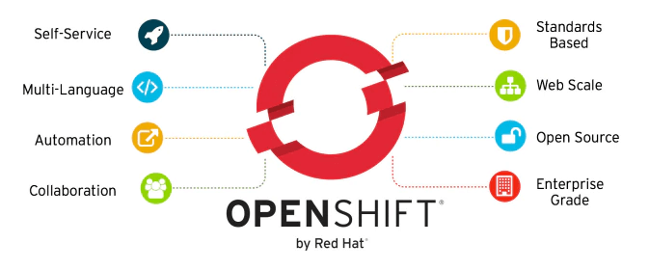
RH OCP Features
Integrated developer workflow.
Routes
Metrics and logging
Unified UI

Slide 10
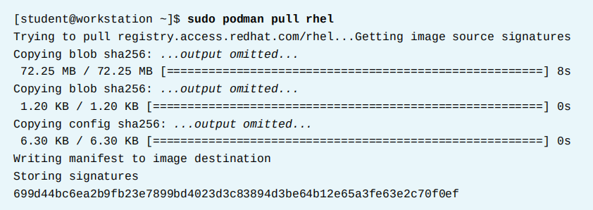
Fetching Image From Image Registry
Running an application inside a container, requires a container image, a file system bundle providing all application files, libraries, and dependencies and the application needs to run.
Container images can be found in image registries. Some of the registries are as followed :
Docker Hub.
Red Hat Quay.
Red Hat Container Catalog.
Container Image Name Syntax
Container images are named, based on the following syntax :
registry_name/user_name/image_name:tag

Slide 11
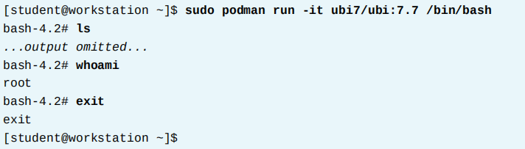
Running Containers
The podman run command runs a container locally based on an image
Use the -d option to run the process in the background
Some Common Container Options
--name : Container Name
-t : Pseudo Terminal
-i : Interactive

Slide 12
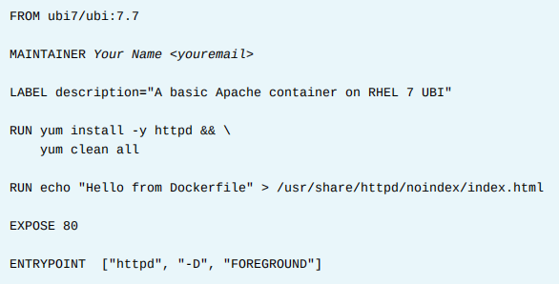
Docker and its Terminologies
To build base container images with Dockerfiles
Create a working directory.
Write the Dockerfile Specifications.
Build the image with the podman or docker command.
A Dockerfile is a simple text file and each line uses the following syntax:
INSTRUCTION arguments
The instructions are executed in the order they appear.
CMD and ENTRYPOINT
Defining an ENTRYPOINT in the Dockerfile creates containers that are
Executables.
The ENTRYPOINT can be script that is added to the container with an ADD instruction.
Sample Dockerfile

Slide 13
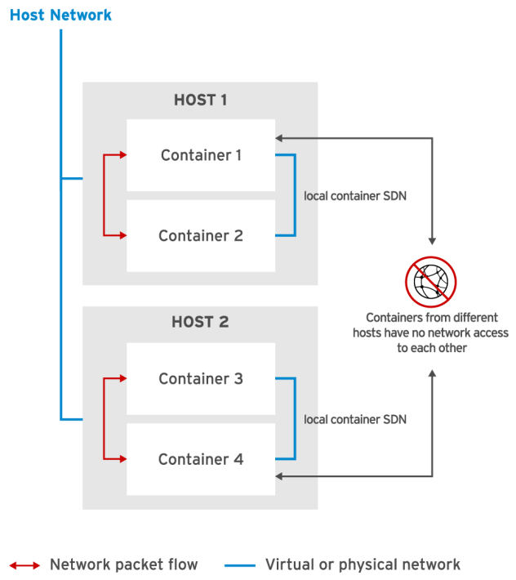
Basic Linux Container Networking
The Cloud Native Computing Foundation (CNCF) sponsors the Container Networking Interface
(CNI) open source project. The CNI project aims to standardize the network interface for containers in cloud native environments, such as Kubernetes and Red Hat OpenShift Container Platform.
Podman uses the CNI project to implement a software-defined network (SDN) for containers
on each host. Podman attaches each container to a virtual bridge and assigns each container a
private IP address. The configuration file that specifies CNI settings for Podman is /etc/cni/
net.d/87-podman-bridge.conflist.

Slide 14
KUBERNETES and OpenShift Resources
Kubernetes Architecture
The smallest unit manageable in Kubernetes is a pod.
A pod consists of one or more containers with its storage resources and IP.
A master node provides basic cluster services such as APIs controllers.
A worker node performs work in a Kubernetes cluster. Application pods are scheduled onto worker nodes.
A controller is a Kubernetes process that watches the resources and make changes based on that state.
Services : Define a single, persistent IP/port combination that provides access to a pool of pods.
Replication Controllers : Defines how pods are replicated(horizontally scaled) into different nodes.
Persistent Volumes and Persistent Volume Claims.
ConfigMaps and Secrets : Contains keys and values that can be used by other resources.

Slide 15
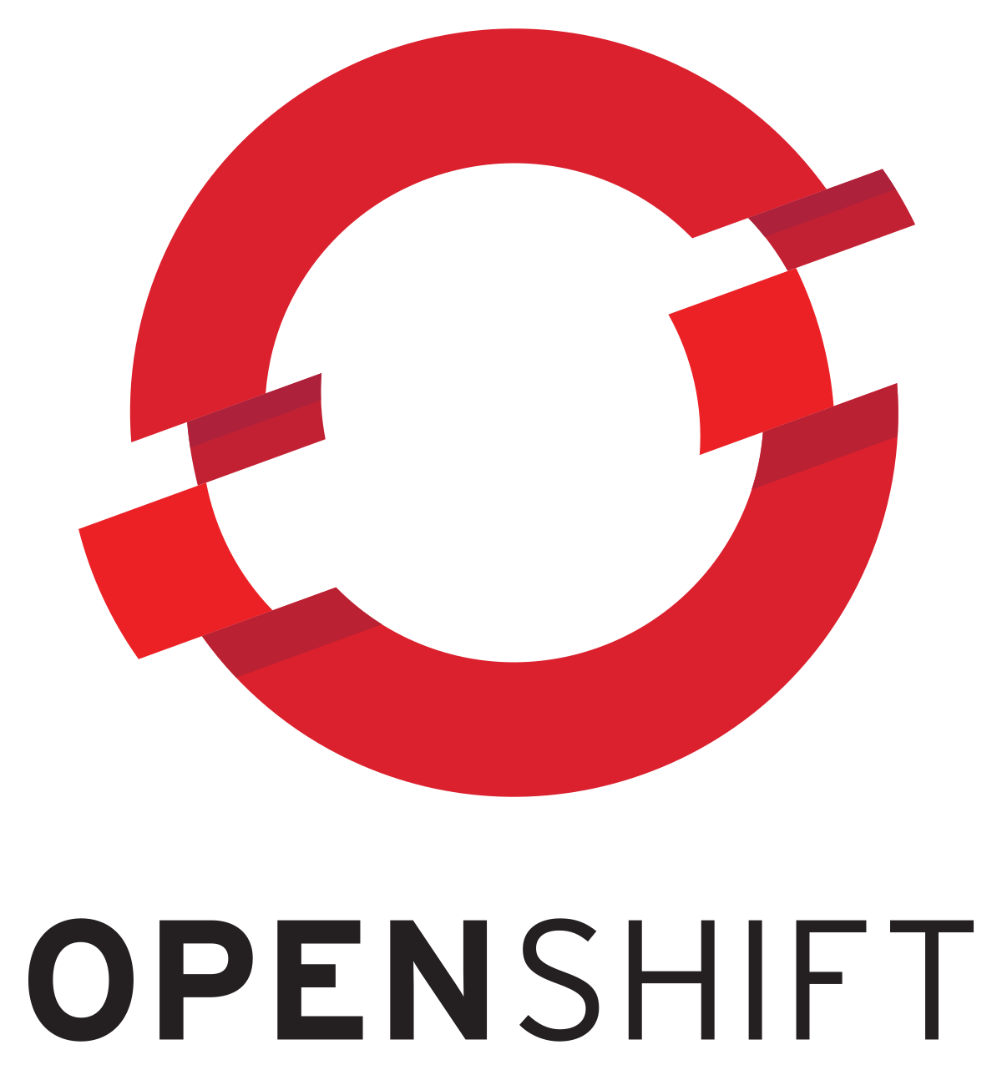
KUBERNETES and OpenShift Resources
OpenShift Resource Types
Deployment Config (dc) : Represents the set of containers included in a pod, and the deployment strategies to be used. A dc can also provide a basic but extensible continuous delivery workflow.
Build Config (bc) : Defines a process to be executed in the OpenShift project. Source-to-image (S2I) feature to build a image from application source code stored in a Git repository.
Routes : Represent a DNS host name recognized by the OpenShift router as an ingress point for applications and microservices.

Slide 16
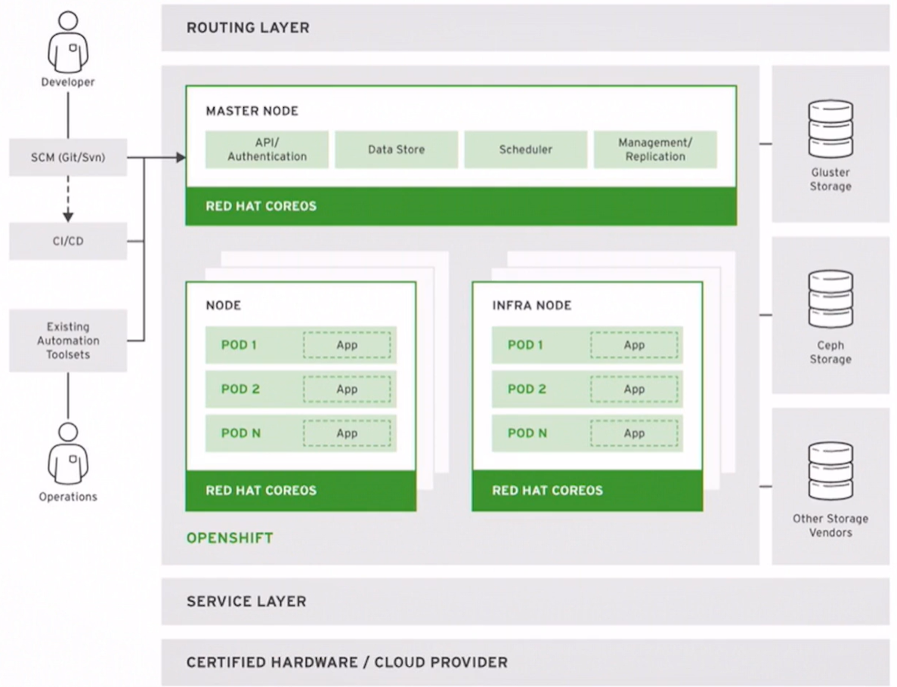
OpenShift Architecture

Slide 17
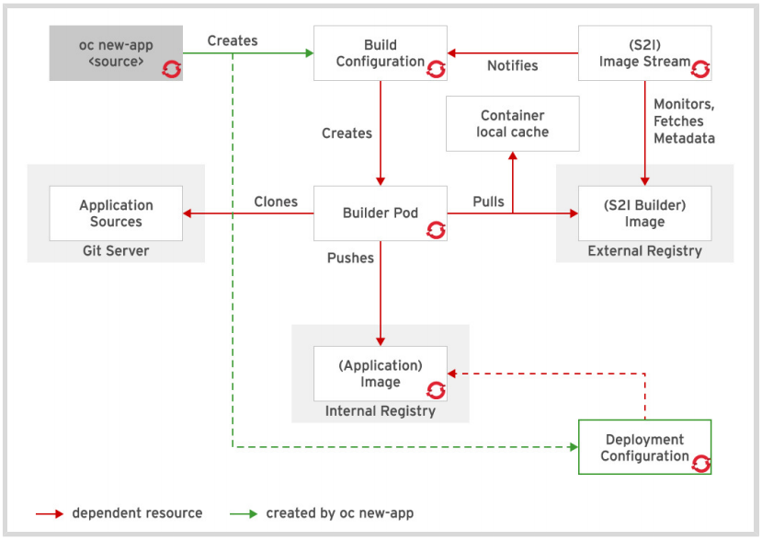
OpenShift Source-To-Image (S2I)
Deployment Configuration
And
Dependent Resources

Slide 18
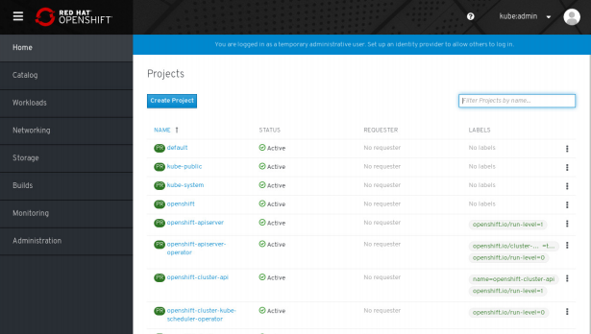
OpenShift Web Console
Web Console
Home Page

